Slide 1
Making Instruments

Slide 2
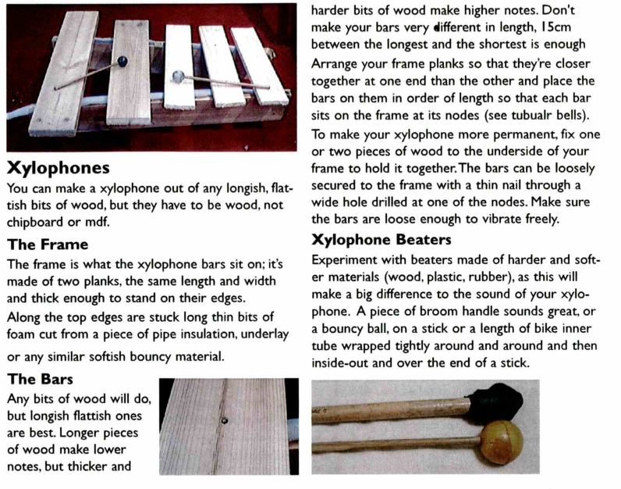

Slide 3
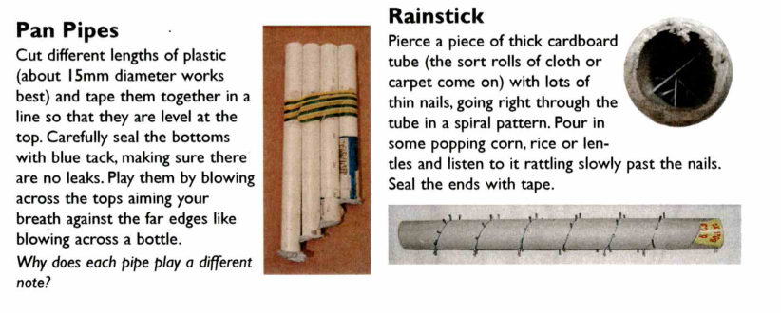

Slide 4
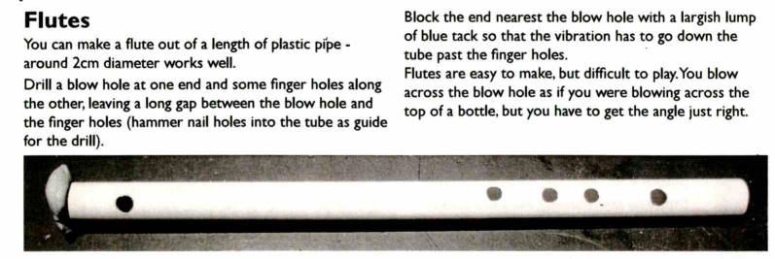

Slide 5
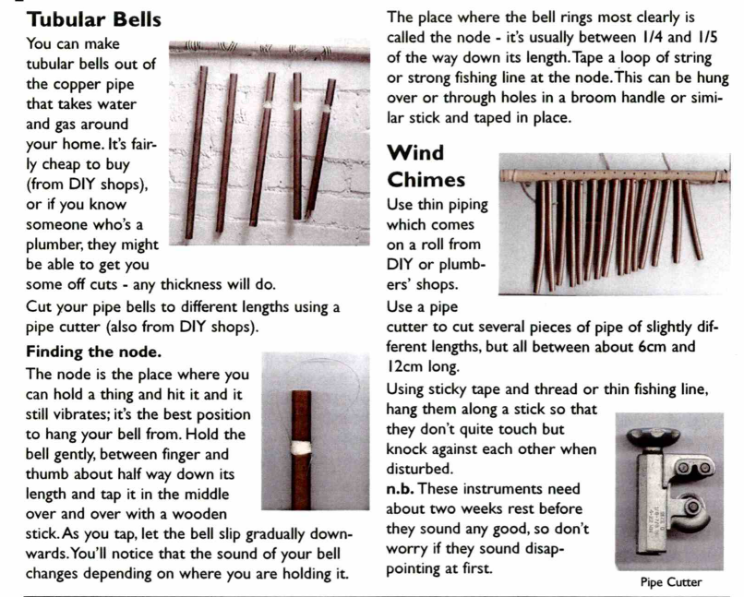

Slide 6
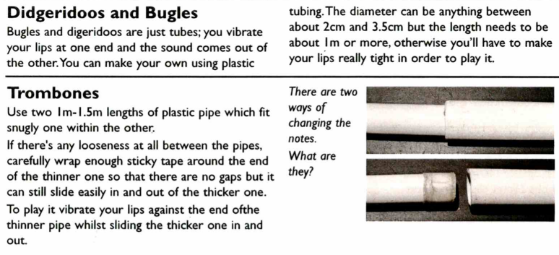

Slide 7
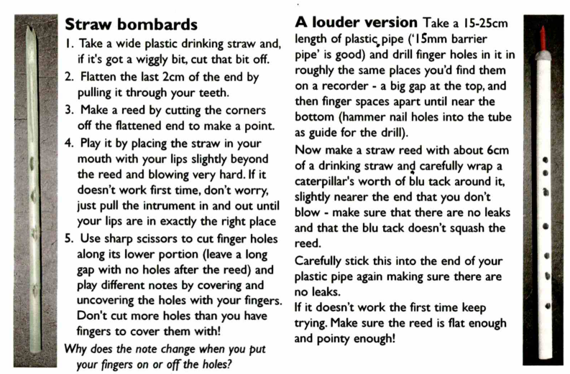

Slide 8
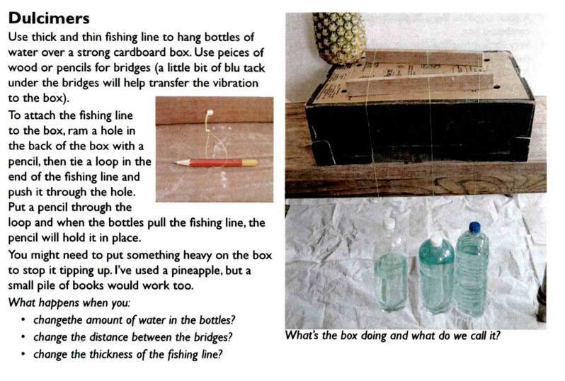

Slide 9
Now it is your chance to decide which instrument you would like to make.
Step 1
When you have decided, try to find some images of it using your Chromebook. Try to find at least three. Copy and paste them into your planning sheet.
The images you find should be different versions of the instrument you want to make. Decide what you want yours to look like by picking the best bits from each image.

Slide 10
Step 2
When you have decided what you would like your instrument to look like, draw it on the sheet provided. Remember to add colour.
Try to draw it from the front and from the side.
You can always change and adapt how it looks as you are making it if you decide to, but you need a plan at the start.

Slide 11
Step 3
After you have drawn your instrument, identify the materials you will need to build it. If you can add measurements, this will make building it easier.
Again, you can change the materials as you make it, but this list will help you get started.
Think where you could obtain the materials from. Can you bring anything in from home?

Slide 12
Step 4
The final planning stage is to write a set of instructions, saying how you will make your instruments.
Add as much detail as possible, including any tools that you may need to use.
Think about any help from an adult you might need

