Slide 1
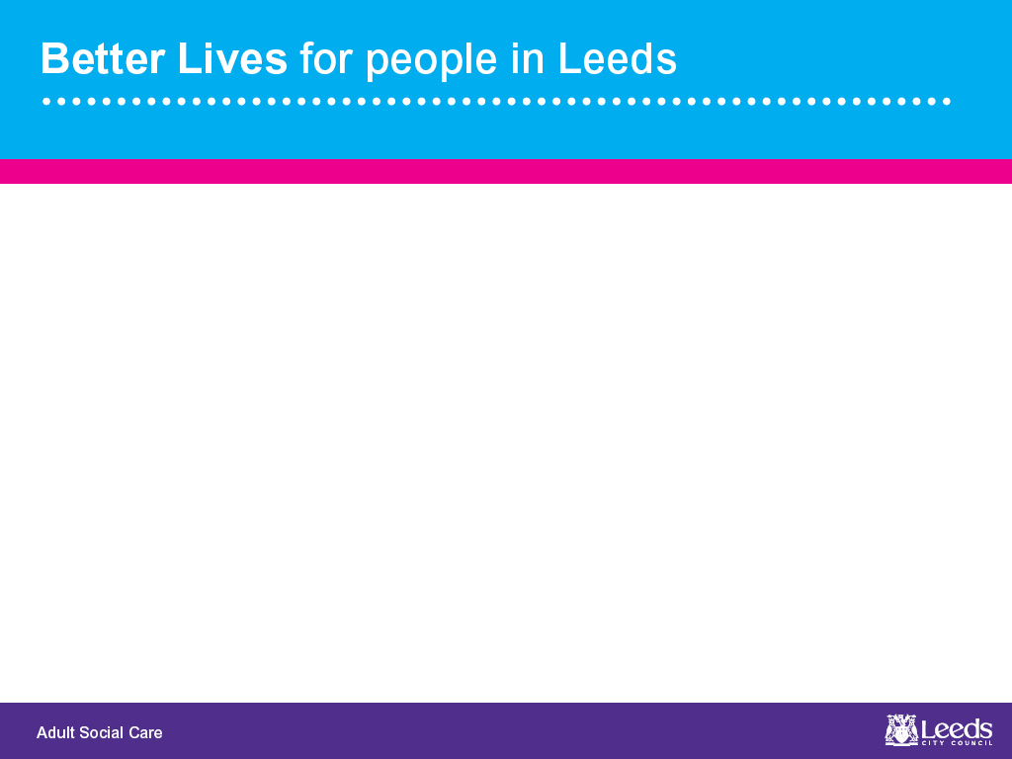
Directions Panel
A multiagency solution for engagement post 18
August 2018

Slide 2

What is the Directions Panel?
…………………………………………………………….
This panel was developed following discussions amongst social care professionals in regards to care leavers and those of care leaving age who present as some of the most vulnerable and chaotic young persons in our community.
There are a number of young adults in Leeds who are identified as being vulnerable to many issues including:
Historic CSE, Exploitation, homelessness, risk to self and others, lack of independent skills and poor engagement with support.
Historically the people identified for these discussion have been difficult to support and in many cases may not be Care Act eligible. This panel allows for ongoing discussion in regards to the individuals identified.
As a result the panel can monitor, signpost and be ready to engage with those in need, particularly where there is risk of crisis.

Slide 3
Who are the panel?
…………………………………………………………….
The panel consists of the following members
2 ASC Service Delivery Managers
1 ASC Team Manager
1 ASC Safeguarding and Risk Manager
Transitions Team Manager
1 CSWS Service Delivery Manager
2 CSWS Team Managers
1 Children's Clinical Psychologist
A representative from housing
A representative from York Street Practice
1 administrator
As well as the main panel, referrers and relevant professionals are invited to discuss individual cases. Time slots are allocated for each case so that time can be dedicated for these discussions

Slide 4
Criteria for Referral to the Panel
…………………………………………………………….
Referrals to this panel are made directly to the panel administrator at kiri.shaw@leeds.gov.uk
In order to make a referral the referrer must provide a name, date of birth and completed conversation record summarising the history and concerns.
To identify those who may be eligible for this input it is necessary to consider if the individual in question meets any of the following criteria:
Be aged between 17 and a half and 25 years old
Risk of homelessness/loss of placement
Vulnerable/risk of harm to self or others
Lack independent living skills
Have poor engagement
Chaotic behaviours and poor engagement with support and advice

Slide 5
Objectives and Benefits
…………………………………………………………….
This Panel has a number of aims and objectives not only for the individual but also for those already working with them and the service as a whole. These are as follows:
The individual:
Reduce the risk
Provide a better quality of life
Provide stability
Promote engagement
Provide a safety net for crises
The Referrer:
To receive professional support and advice
Shared responsibility of risk
Connect to services to support their role
The Service:
Reduce the risk
Promote engagement with individuals
Reduce longer term demand
Reduce longer term costs

Slide 6
Monitoring cases
…………………………………………………………….
Having been established less than a year ago this panel continues to develop to meet the needs of the service we aim to provide to the young adults of Leeds.
To ensure that progress towards individual cases and the service is monitored, a fully auditable process has been devised in the form of a tracker for ongoing cases. This is shared with the panel in time for every meeting so that attendees can review previous discussions. This allows for a timeline of involvement by the panel which reflects the journey of the case.
Further to this, discussions are then uploaded to CIS in the form of casenotes. Where there is no previous ASC involvement, referrals are made at the recommendation of the panel so that a CIS record can be made.

Slide 7
Outcomes
…………………………………………………………….
Due to the complex nature of the cases involved in this work, it is not always possible to reach an absolute resolution. However, the panel keeps cases on for discussion until a suitable outcome is reached. This can include any combination of the following outcomes:
Allocation of PA
Rehousing
Engagement with meaningful activity/work/education
Rehousing/Housing support
Suitable placement
Return to family home
Engagement with services
Referral to Transitions Panel (if new diagnosis established)
Referral to health services
Introduction of any other relevant support

Slide 8
Case Study 1 – “Thomas”
…………………………………………………………….
“Thomas” is an ongoing case at panel and one of the more chaotic cases discussed. It seems this young man may be some way off a “desirable” outcome, however these kinds of discussions support the involved professionals and assure them they are making suitable decisions. “Thomas” is described as follows:
Known to CSWS due to assaulting his mother.
Previously remanded in a secure unit due to suspicion of involvement in a stabbing and robbery.
Subject to community supervision order.
Psychological concerns which cause issues in relationships.
SALT assessment advises of an understanding of language in line with that of a child between 7 - 10 years.
At the present time this young man is now going through the criminal justice route and all involved are awaiting a court date. However discussion at panel has allowed for joint working between relevant professionals. As a result a risk management meeting will be held with a focus on supporting “Thomas” and planning what action could be taken and support put in place to reduce such behaviours and activity in the future.

Slide 9
Case Study 2 – “Kevin”
…………………………………………………………….
“Kevin” is currently discussed at panel. There is not yet an outcome and still some ongoing concerns which the panel are supporting the worker with. He was referred to the panel for the following reasons:
Previously in foster care.
Previous use of bed space.
Isolated and displays lack of motivation.
Easily exploited by both family and peers.
Previously has spent time at his mothers and sisters respectively but then asked to leave once his money runs out.
Poor budgeting and domestic skills.
PA involvement.
With the advice and support of the panel the current worker will be completing relevant capacity assessments and information on assessments completed in childhood will be shared to inform social work decisions and identify more suitable accommodation

Slide 10
Case Study 3 – “Kirsty”
…………………………………………………………….
“Kirsty” was one of the first cases discussed at the panel and her behaviours and history were a great source of concern to involved professionals. A summary of the nature of concerns is as follows
Learning difficulties, history of emotional neglect and diagnosis of Emotional Borderline Personality Disorder.
Spent childhood between parents and paternal grandparents.
Police caution for assault on grandmother and 7 year old sister.
Spent time in foster placement which broke down.
Lives in supported accommodations.
Exhibits dangerous and challenging behaviours i.e. walking into traffic.
Conducts risky sexual relationships with peers and has made allegations of rape.
Following discussion and monitoring by the panel, a case was made for referral to ASC for more formal support. As a result “Kirsty” was seen at a talking point and now has support from a social worker and St Anne’s support worker so that some of the risks can be addressed and reduced.

Slide 11
Moving Forward
…………………………………………………………….
As this panel continues to grow and develop, some analysis work will be undertaken to identify themes and monitor the impact of these discussions on this cohort of people and the services involved.
With the ongoing commitment of those involved it is hoped that this piece of work can embed a supportive approach to both services users and professionals. Further to this some preventative action can be taken to ensure those in need do not go without support and instances of crisis may be reduced.
It is felt that this panel has identified a gap in the services we provide under the relevant legislation. This work will hopefully achieve a more sustainable long term approach to these cases and influence the way we support people to transition into adulthood.

Slide 12
Questions?

Slide 13
Thank You for listening

